Slide 1
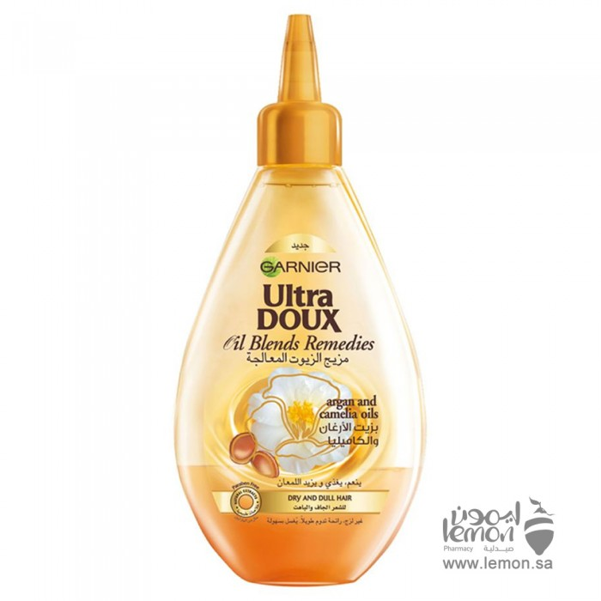
Hair Oil Garnier Ultra Do Mix Oils Treated With Argan Oil And Special Camellia In Dry Hair 140ml
SAR 19.67. Q

Slide 2
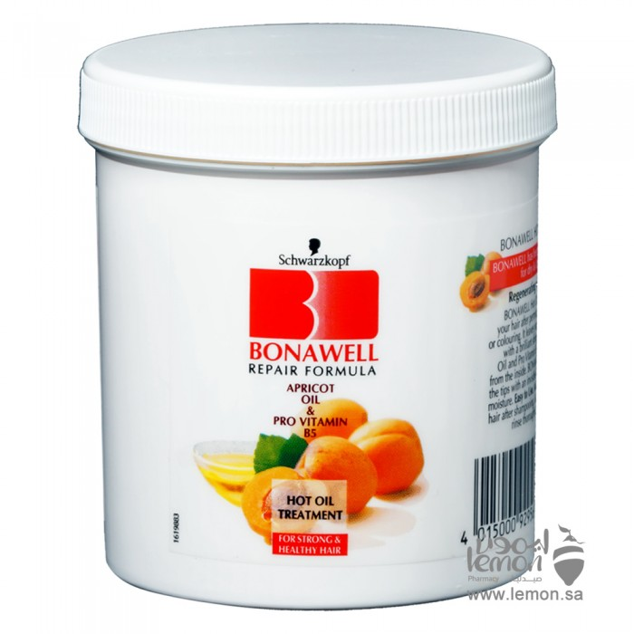
Schwarzkov Bonawell Oil Bath For Apricot Hair 810ml
49.68 SA. Q
Easy to use wash your hair in shampoo, dry it with towel, then gently massage the lotion on the hair. Let it perform for only 3-5 minutes, then rinse your hair thoroughly and lay it off as usual.

